Slide 1
Machine Learning for Lunar Multi-Static Ground-Penetrating Radar
Team member: Bhanu Sharma, Cheng-Hao Hsiao, Chi Chen, Jyothirmayee Donthineni, Meharleen Singh, Piyush Tandon, Sam Kinn
Name of Industry: NASA Jet Propulsion Laboratory
Industry mentor: Dr. Daniel Nunes, Jack Lightholder
Faculty mentor: Prof. Jenq-Neng Hwang

Slide 2
Team
Chi Chen Machine Learning Engineer / Data annotation expert / Feature engineering
Cheng-Hao Hsiao Software Architect / Machine Learning Engineer / Point of Contact
Sam Kinn Image Processing Software Engineer
Jyothirmayee Donthineni Image processing/Machine learning engineer
Piyush Tandon Mechanical Engineer
Bhanu Sharma Software Engineering
Meharleen Singh Image Processing / Software Deep learning / Hardware

Slide 3
presentation
Sam: objectives , GPR Instrument/Data Background , wavelet, Layer Classifier - CNN, Model Training Approach Q2, Schedule.
Bhanu: Machine Learning for Science/Spaceflight, Model Selection (Trade Study), multiclass classification -RCNN, Hyperbola Classifier - RCNN, Filler Attention Maps, Model Training Approach Q3, Risk
Chi: Machine Learning Plan Overview, lbp, hog, Layer Classifier - SVM, Hyperbola Classifier - random forest, Model Evaluation, Model Training Approach Q3
Hao : Labeling Strategy, Data Annotation, Dataset Generation, Model Training Approach Q1,3, Voting Ensembles, Inference Pipeline.
Jyothi : Featurization Strategy, edge detection, Hyperbola Classifier - DT, Hardware - Budget, lesson learned, Model Training Approach Q4
Mehar: hough transform, a filter(?) for pre-processing, Model Selection - Deep Learning, multiclass classification -YOLO, Model Training Approach Q3, demo2
Piyush: work flow, hardware, deployment, demo1, Future work

Slide 4
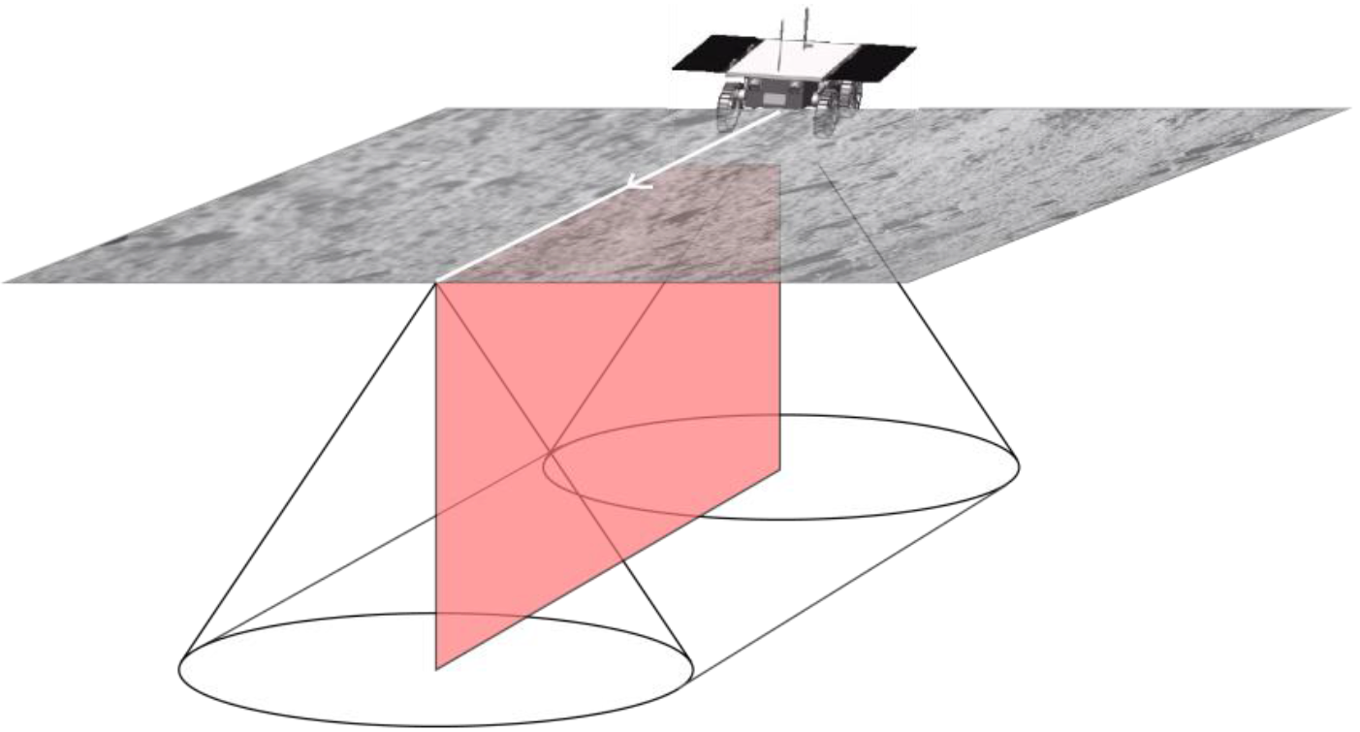
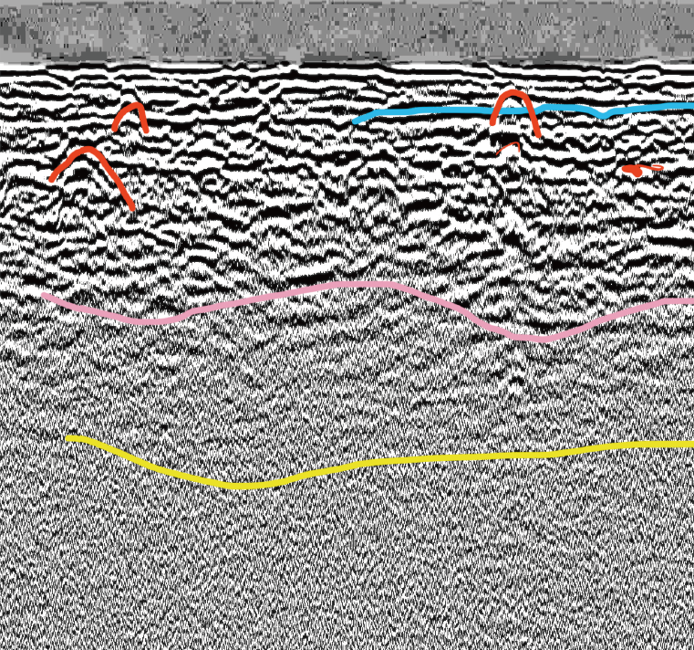
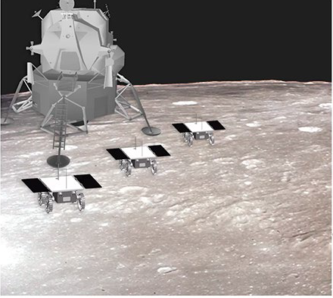
Objective
There are many applications where it is desirable to image the subsurface nondestructively
In this scenario, we want to be able to image the subsurface of extraterrestrial bodies such as the Moon and Mars
Ground-penetrating radar (GPR) provides a means of doing this in a cost-effective manner
Our long-term vision is to deploy an image processing and machine learning pipeline to extract meaningful information about the surface from GPR data
This review covers the exploration and implementation of our machine learning pipeline for identifying objects in 2D GPR data
Parabolas
Reflectors

Slide 5
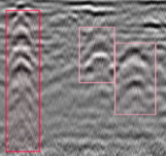
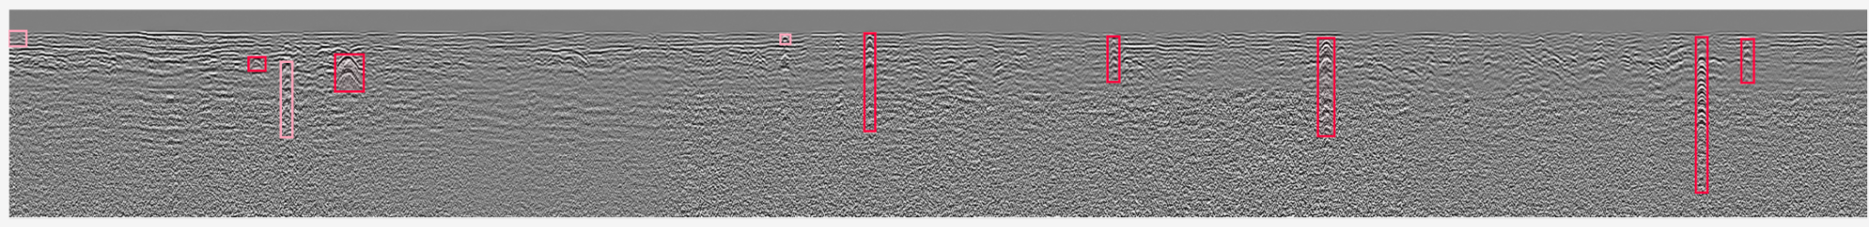
GPR Data
Parabolas
GPR devices send radar pulses into the ground and use antenna to capture signals that have returned as pulse is reflected, refracted, scattered back to the surface
Strongest signal strength of antennas occurs close to the ground
EM properties of materials can limit penetration depth of radar
We are primarily looking at 2D image data derived from signal processing of incoming radar responses
Reflectors

Slide 6
Machine Learning for Science/Spaceflight
What makes this project unique:
Data (GPR images from moon) that the model sees during deployment would be very unique in nature.
Model inference needs to take into account of hardware and environmental constraints when it would be run.
Preference to explainability.
Things needed to be considered when working in the science/engineering domain that traditional machine learning projects might not have:
Model results have to be interpretable. One has to be clear why a certain detection was done.
All methodologies have to be compared on given project benchmark.
Hardware resource constraints.
Low/quick inference time.
The model has to be robust and generalised.
Benchmarking the model with unique hardware and environmental constraints.
Notes:
bhanu

Slide 7
Machine Learning Plan Overview
Classifier goals – starting from hyperbola / reflectors binary classifier to multi-class classifier
Data sources – processed real lunar GPR images from NASA
Label target in strong / weak class as easy / hard training dataset
Use sliding windows with overlap to cropped image to generate larger dataset
Consider model size and complexity / hardware compatibility for running in embedded systems

Slide 8
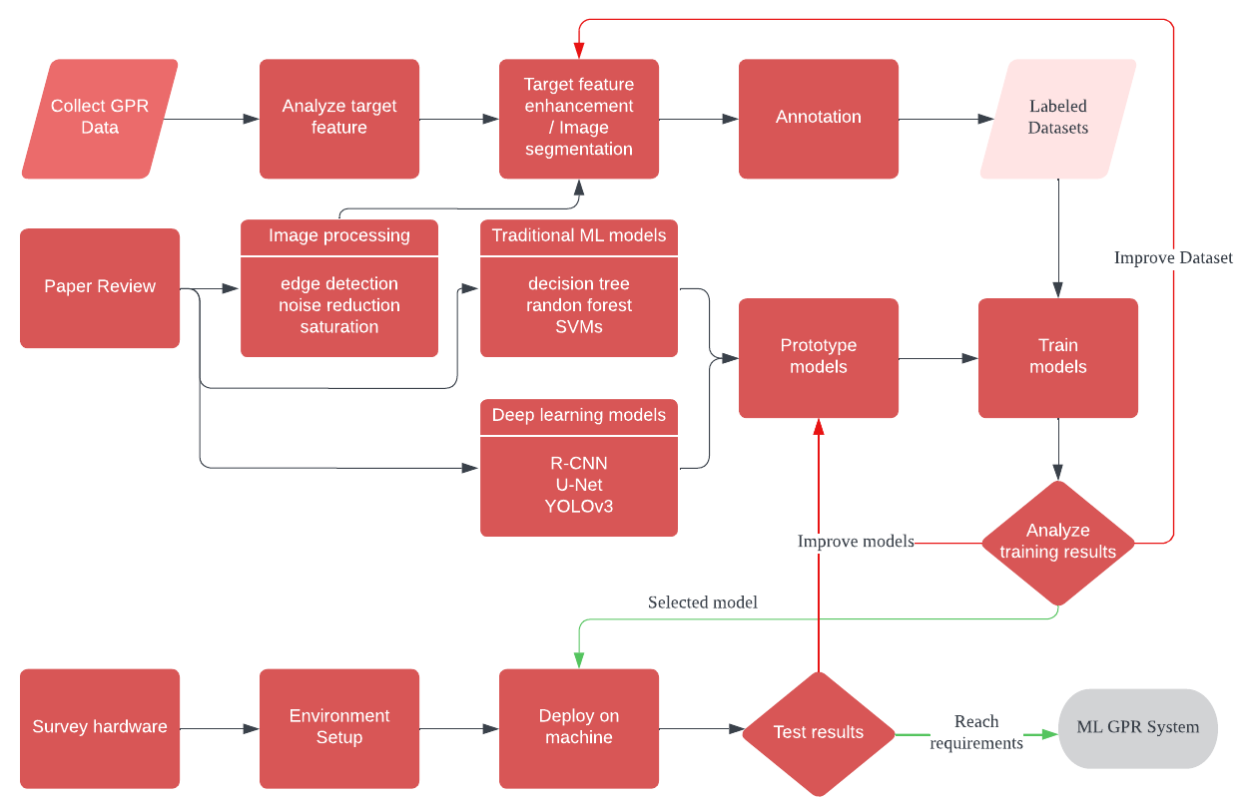
Workflow

Slide 9
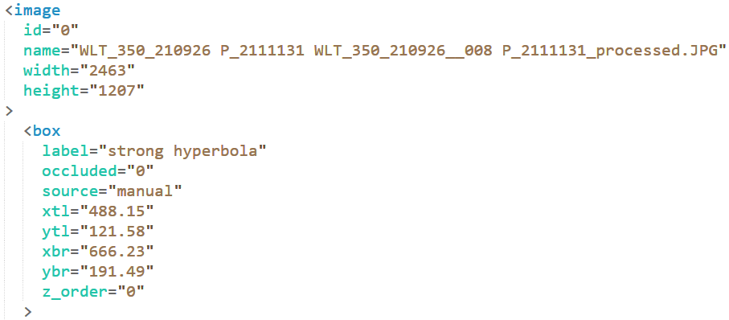
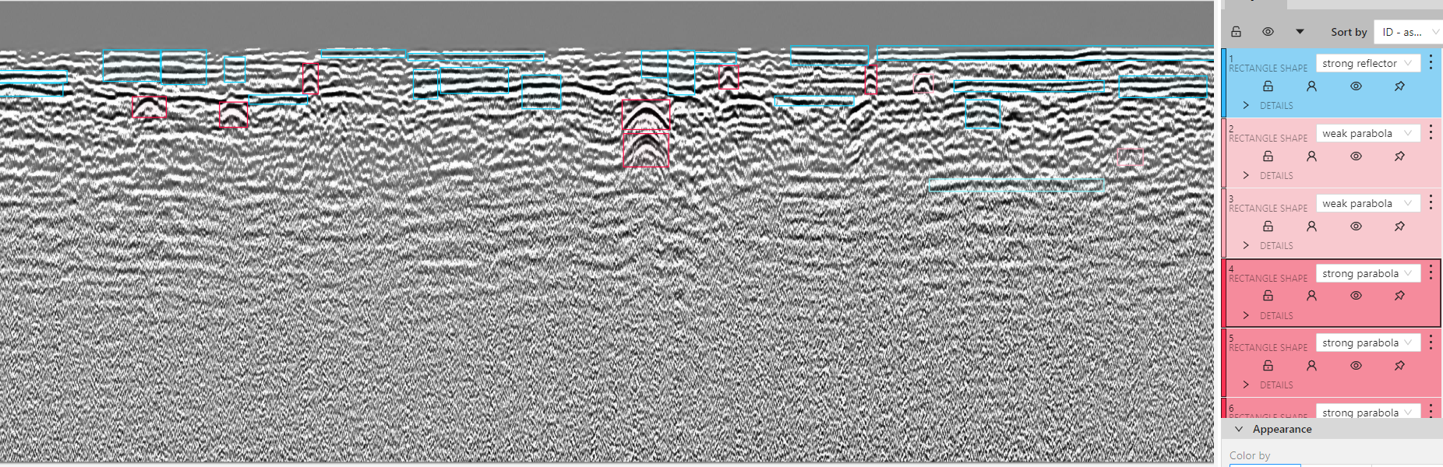
Data Annotation Tool & Strategy
Use CVAT for data annotation and export annotations in XML format
One people label data batches and 2-3 people review data for consensus.
0
x
y
Notes:
How did you go about labeling? What tools did you use? CVAT
One people label data batches and 2-3 people review data for consensus.

Slide 10
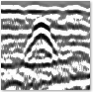
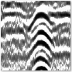
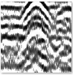
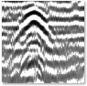
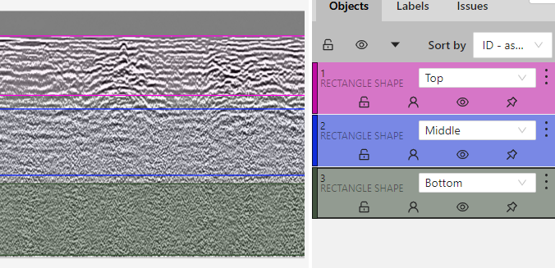
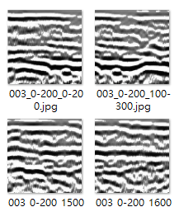
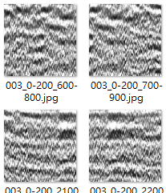
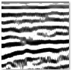
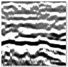
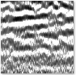
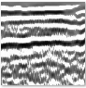
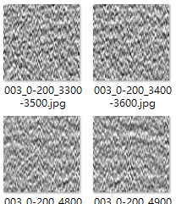
Data Annotation Set
Strong hyperbola
Top layers 513 images vs. others (middle layers, bottom layers) 1143 images
Hyperbolas 50 images vs. others (reflectors, environments) 100 images
top
middle
Strong reflectors
bottom
Notes:
Geologic features you’re labeling
How many labels do you have in each class? Do you have batches of data you use for different purposes? I.E. easy set, medium set, hard set? What is in each set?
easy set: single class clear hyperbola/reflectors
medium: single class hyperbola/reflectors
hard: multi class hyperbola/reflectors

Slide 11
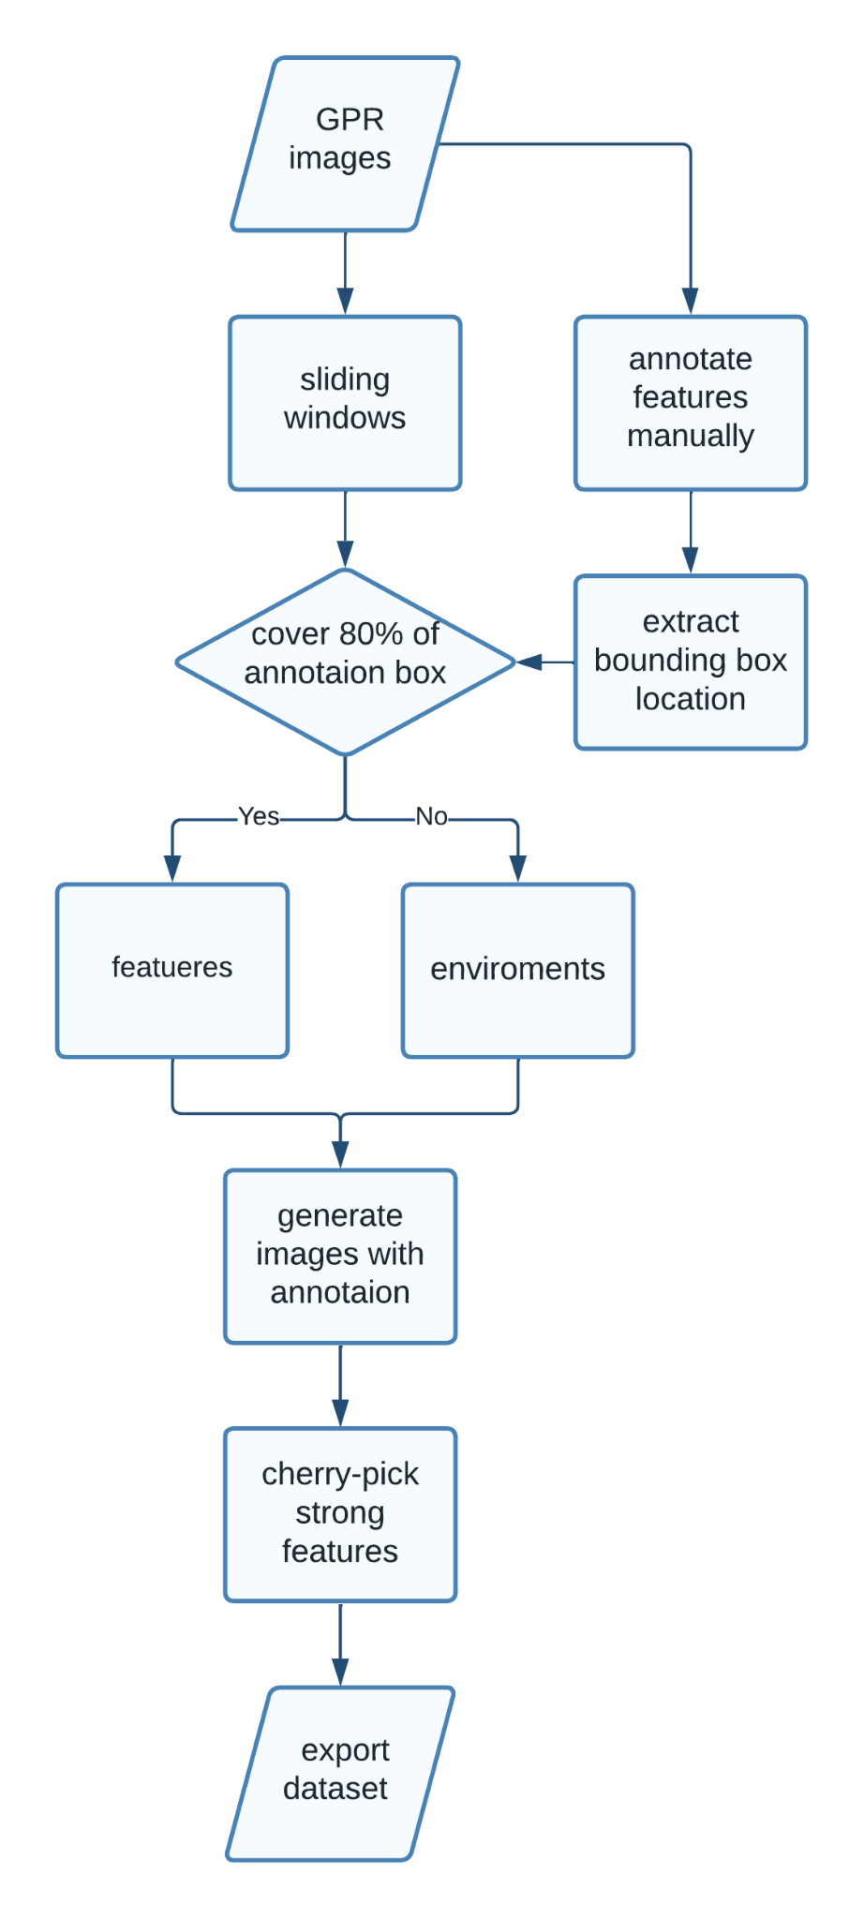
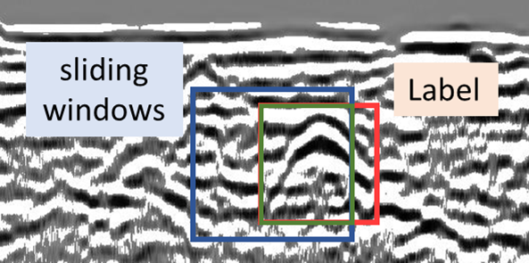
Dataset Generation
Use sliding windows to cropped image
200 x 200 pixels can cover most hyperbolas
80% of overlapping
Extract annotations information from parsing CVAT xml
Combine sliding window and annotation information to labeled images
Label cropped images based on covering 80% of annotations box
Cherry-pick strong features
Export dataset in npz format

Slide 12
Featurization Strategy (feature lists)
 | Feature | Description
1 | Local binary patterns histogram | popular for extracting local texture pattern (strongest local grayscale)
2 | depth | depth of the sliding window of original gpr image
3 | wavelet transform | using fixed window to create a local frequency analysis
4 | FFT | spectrum analyzing, powerful for distinguishing different depths of GPR
5 | Gabor filters | sensitive to both the frequency and orientation of texture patterns
6 | Number of pixels of edges | Count pixels after do Sobel edge detection
7 | Number of edges | Count lines after do Canny edge detection
8 | Histogram of Oriented Gradients | local gradient pattern, hyperbola and reflector has unique gradient pattern
9 | standard deviation of the mean of rows | Indicate the similar gray level in the horizontal line.
Notes:
Which features were valuable? Why do you think they were?
Which features did you implement?

Slide 13
Featurization Strategy (feature lists)
 | Feature | Description
10 | Mean of peaks and valleys in the image | mean number of peak and valleys in each column
11 | standard deviation of whole picture | Noise of picture, easy to calculate but lack of local pattern
12 | Haralick Texture Features | Texture of an image by computing statistics from the gray-level co-occurrence matrix (GLCM) Set of 13 texture features including Contrast, Correlation, Energy, Homogeneity of image
13 | Laplacian mean | Edges and details of the image
14 | Hu moments | set of 7 Hu moments, shape features invariant to rotation, scale, and translation
15 | zernike_moments | shape features invariant to rotation, scale, and translation (radial and angular moments of an image's contour)
16 | Fourier shape features | represent the shape of an object in terms of its frequency components
Notes:
Which features were valuable? Why do you think they were?
Which features did you implement?

Slide 14
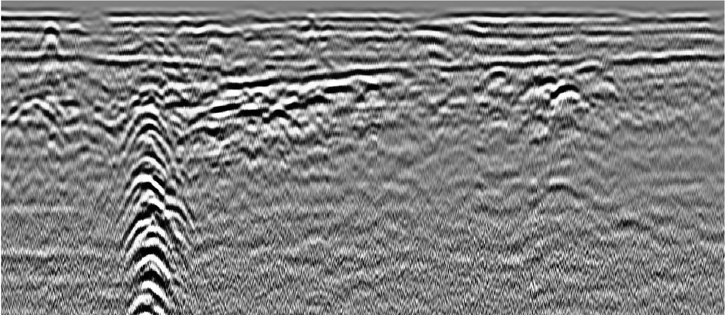
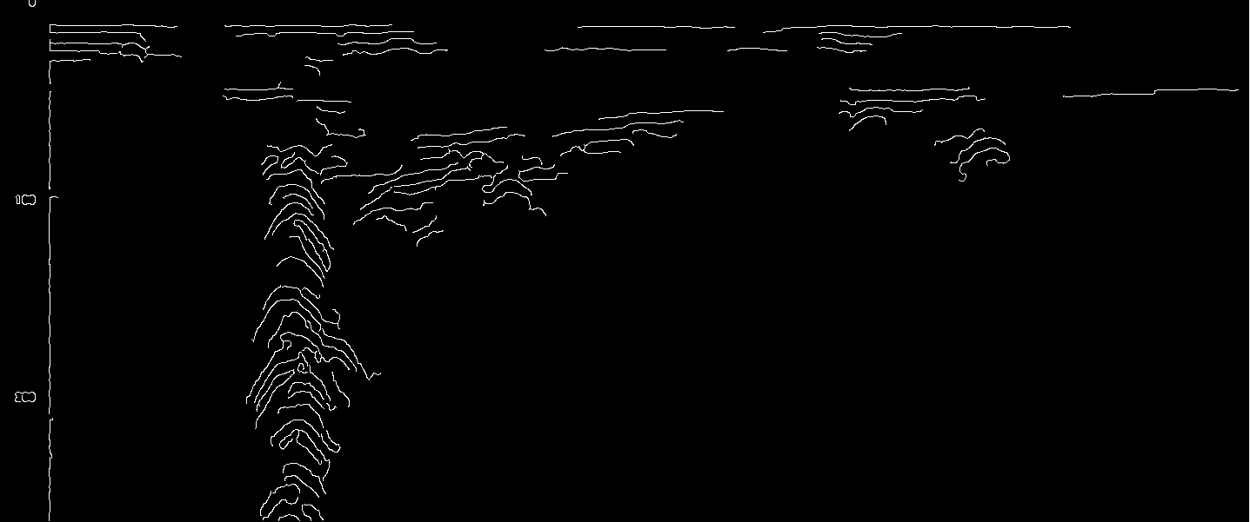
Feature Extraction - Edge Detection
Simple technique for computing gradient differences between pixels
Canny edge detection
Sobel operator
Other techniques explored:
Image thresholding
Contouring, area based contour filtering.
Hough transform for curve detection, Hough parabola detection
Combination with wavelets

Slide 15
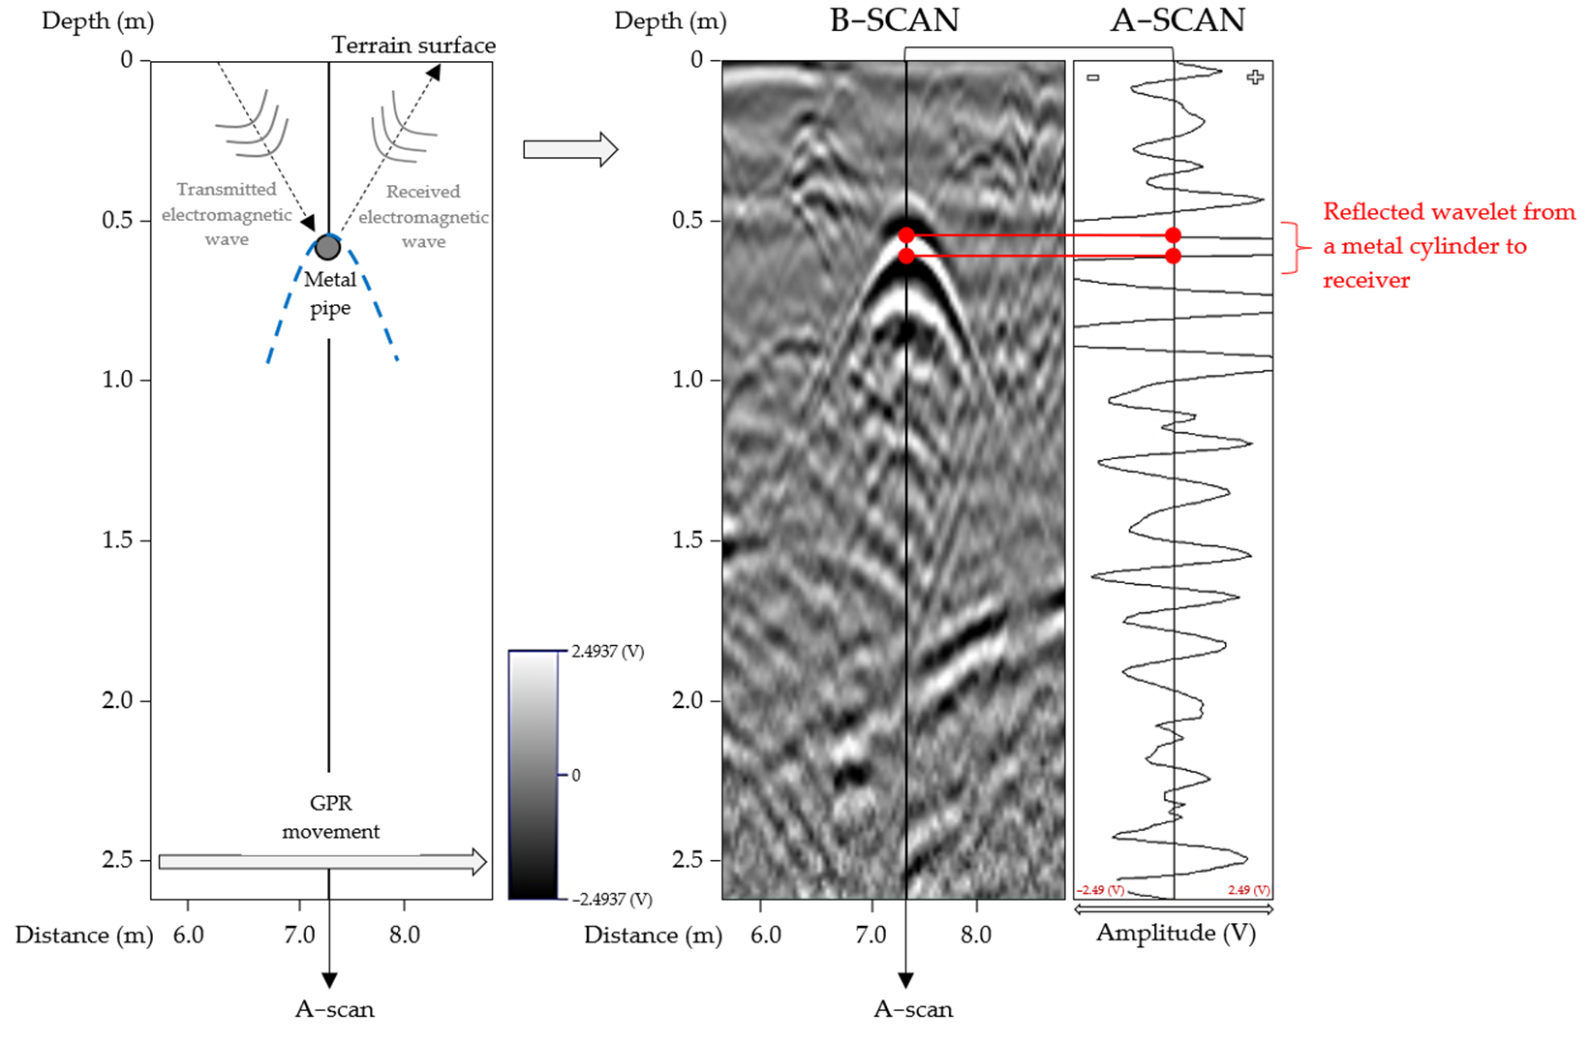
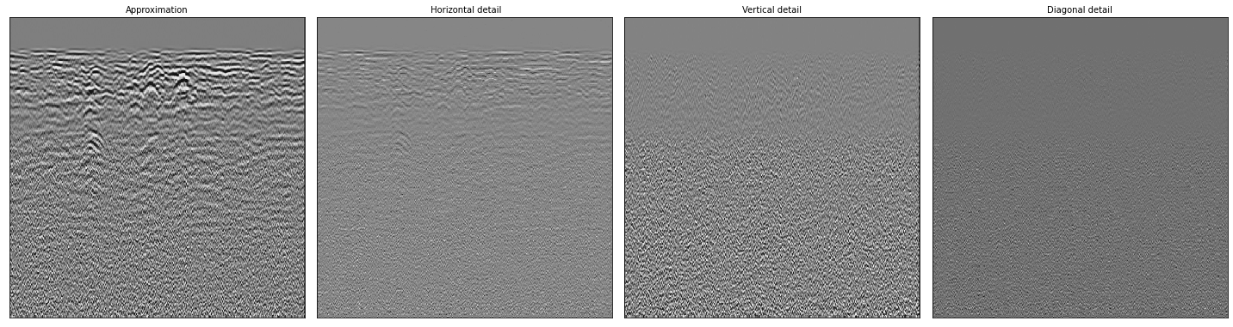
Feature Extraction - Wavelets
Wavelet analysis identify candidates for apex of hyperbola
Casts a wide net, often includes reflectors and other artifacts
Determine coefficients that fit best to determine if candidate is hyperbola
Still work in progress
Requires knowledge of possible hyperbolas
If this works, improves hyperbola detection and classification
Very effective for differentiating layers for layer classification
Onyszko K, Fryskowska-Skibniewska, A. 2021.

Slide 16
So now what? - Alternative approaches
Image processing
Traditional learning
Manual artifact finding
Adjusting images
Shape detection techniques
Hough Transforms
Shape models
Preprocessing and filtering

Slide 17
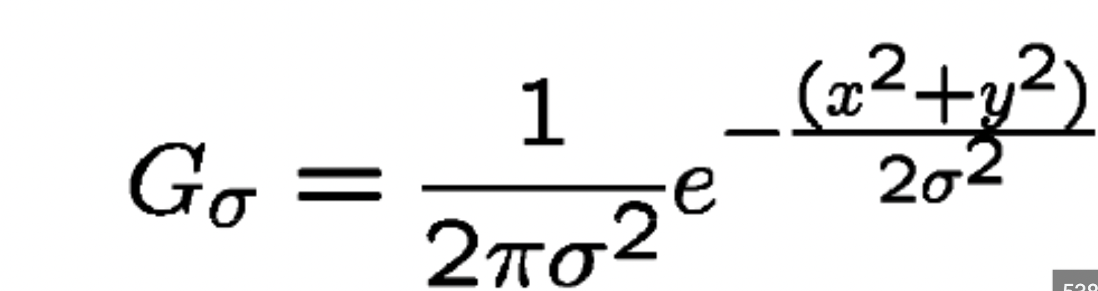
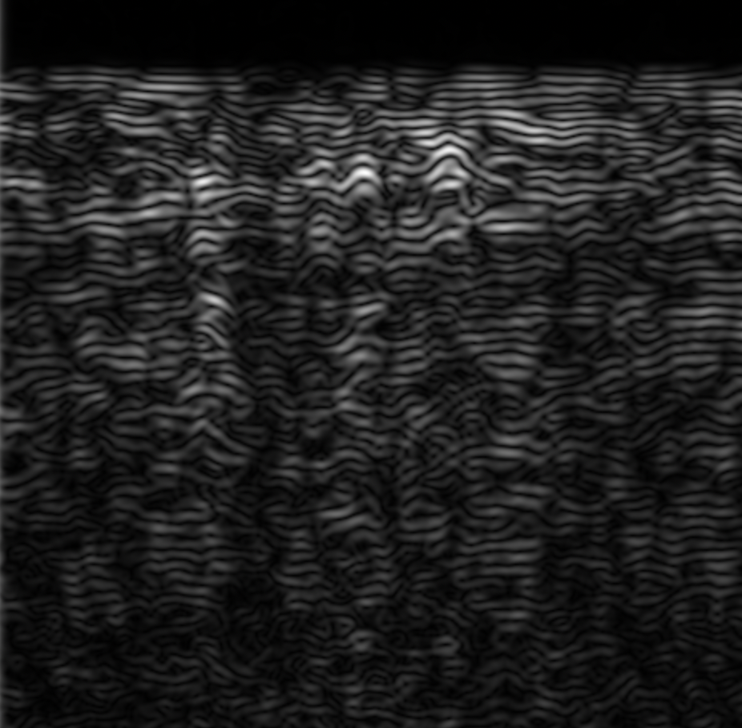

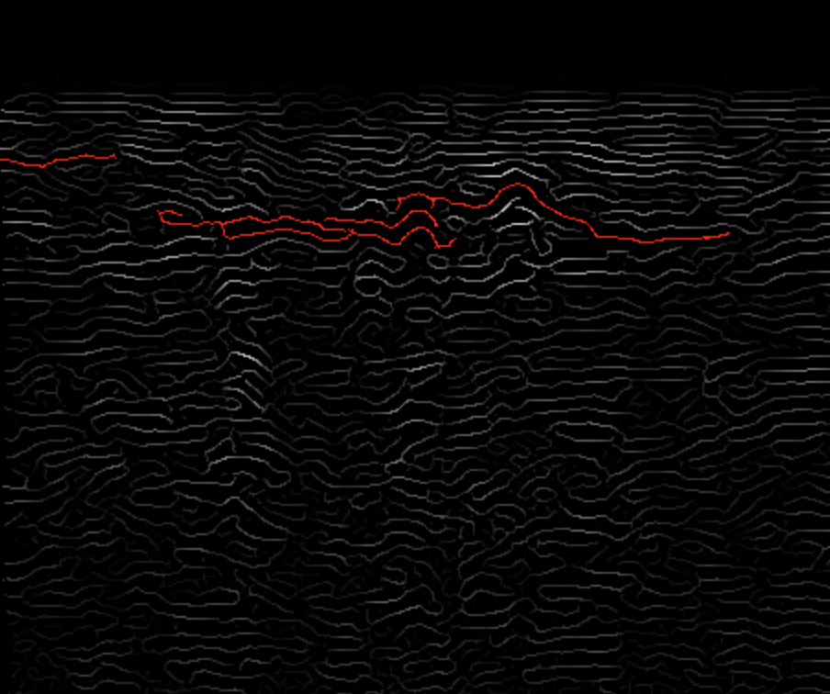
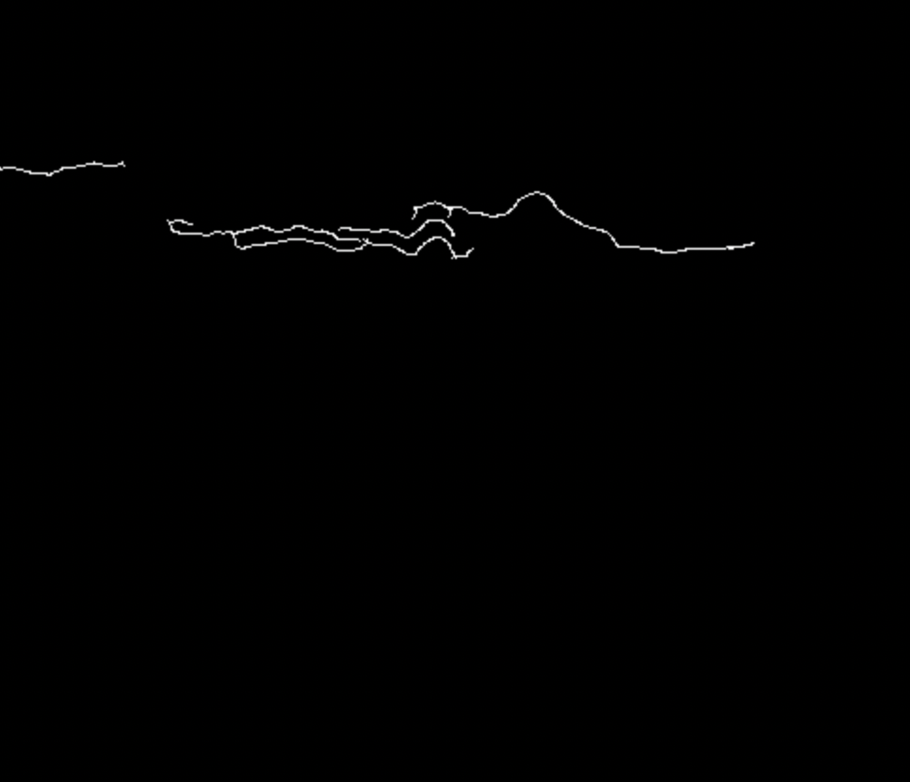
Feature Extraction - Filtering
This is the current equation being adjusted to get the best filter. →
Currently tried using transforms for image Processing.
Stage 1
Stage 2
Stage 3
Stage 4
→
→
→
→

Slide 18
Hough transform - Small intro
The Hough transform algorithm works by transforming each pixel in an image into a parameter space.
The parameter space is a two-dimensional plane where each point represents a line in the image. The two axes in the parameter space represent the slope and the y-intercept of a line in the image. For each pixel in the image, the algorithm calculates the corresponding slope and y-intercept values and plots them as a point in the parameter space.
To determine the location and orientation of the line in the image, the algorithm calculates the intersection points between the sinusoidal curves and the parameter space axes. The intersection points represent the slope and y-intercept values of the line in the image.

Slide 19
Hough transform - Use cases
The hough transform is particularly good at detecting lines and circles. The circle detection process is similar to detecting lines
The use case for GPR images would be adjusting this to detect hyperbolas, however one thing that has to be kept in mind is that transforming shapes like circles or ellipses which are not only already implemented but have been thoroughly refined for detection in Hough transforms can be mathematically altered to just detect hyperbolas.

Slide 20


Hough transform - Application (Line detection)
Lets first test our parameters and use an example image:
Simple hand drawn image:

Slide 21
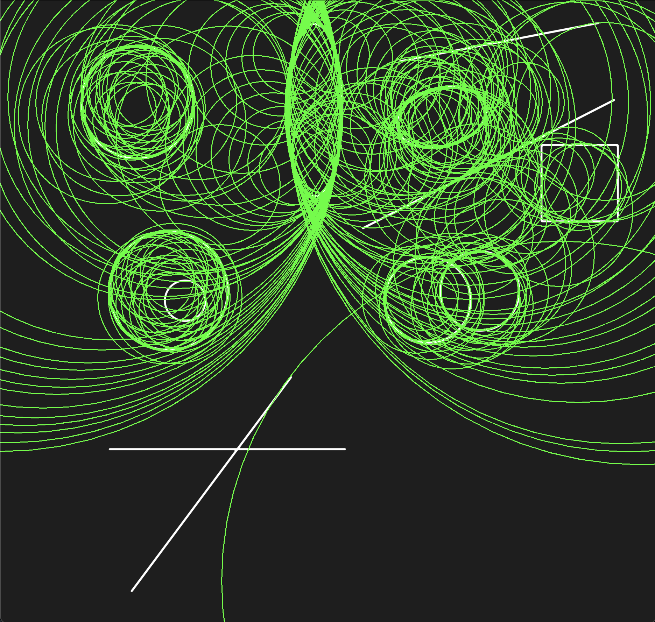
Hough transform - Application (Circle detection)
Next let’s try detecting circles in the same image:

Slide 22


Hough transform - Application (Hyperbola detection)
But what about hyperbolas?
Let’s add those to the mix:

Slide 23

Hough transform - Hypothesis of application
Let’s take a closer look at the first parabola, ideally our dataset and general GPR datasets have this hyperbolic shape; the other shape is rounder and elliptical (explain half-ellipse approach)
This is an interesting find because two circles that overlap and intersect at two points; the outer shells give us a pretty close shape to a parabola:

Slide 24
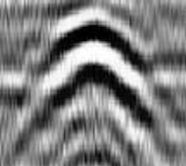
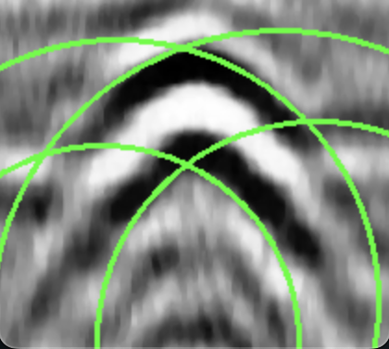
Hough transform - Test
Finally let’s now apply this to actual data and see if our theory is right:

Slide 25
Hough transform - Conclusion
Even though this was effortless in the hand drawn images, denoising, preprocessing and then applying this can be done to detect local hyperbole even in GPRs.
If this approach is used in the future, there needs to be a lot of work done in terms of parameterizing sizes and circles according to the image and scale so that false detections are removed.

Slide 26
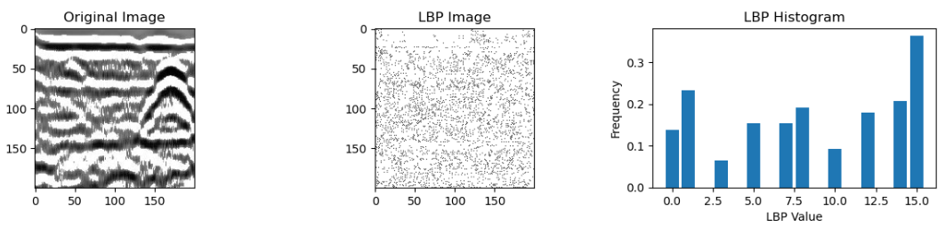
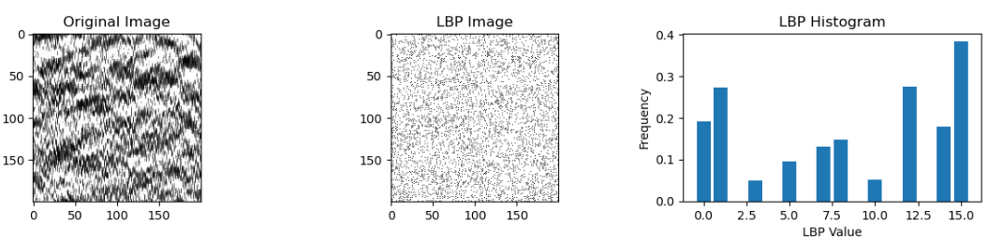
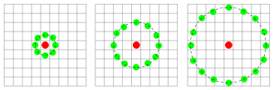
Feature Extraction - local binary pattern histogram
Used in face recognition, texture classification, and radar data.
The LBP histogram is a representation of the distribution of LBP values in an image.
labels the pixels of an image by thresholding the intensity of its neighboring pixels.
source:https://en.wikipedia.org/wiki/Local_binary_patterns

Slide 27
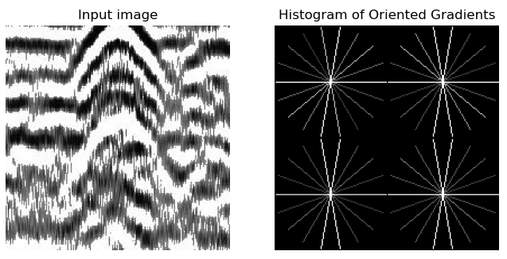
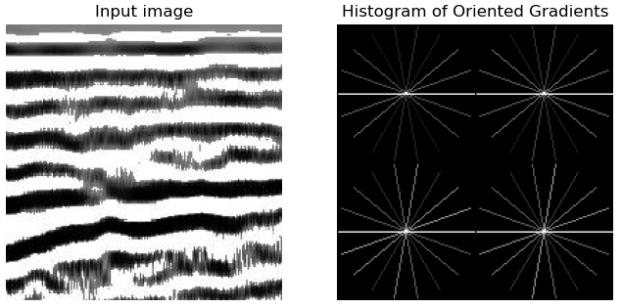
Feature Extraction - Histogram oriented Gradient
Histogram oriented Gradient
Used in computer vision for object detection and recognition. Some GPR research also use it to detect hyperbola[3].
Dividing an image into small cells and computing the gradient magnitude and orientation for each pixel in each cell.
The gradient orientation is quantized into a discrete set of orientation bins.

Slide 28
Model Selection
Model | pros | cons
SVM | separates data points using a hyperplane effective when dealing with high-dimensional data | Normalization is needed.
Random forest | combines multiple decision trees to improve performance and reduce overfitting Feature normalization is not needed | Performance is not good as SVM, Larger training time.
Decision Tree | Helps in feature selection | Performance is not as good as SVM
CNN | Performance is really good | The model has issues in generalisation and explainability.
Darknet (yolo) | Low inference time | Unable to converge due to less data.
Traditional ML vs deep learning
Traditional machine learning
Notes:
bhanu

Slide 29
Model Selection - Deep Learning
Why Deep learning?
Practicality
Running on a SoC on the moon with limited resources
Testing Models based on response and hardware constraints
Arriving at YOLO.
Image size and depth considered.
Finding the balance between size/performance/accuracy.
Being mindful of Pre-processing constraints.
Tuning and running the model
Notes:
Bhanu

Slide 30
The data issue:
The issue that is obvious is data. This is an issue not just because of the kind of data but because of the sparsity.
Another big issue was with the refactoring data (The images did not scale well)

Slide 31
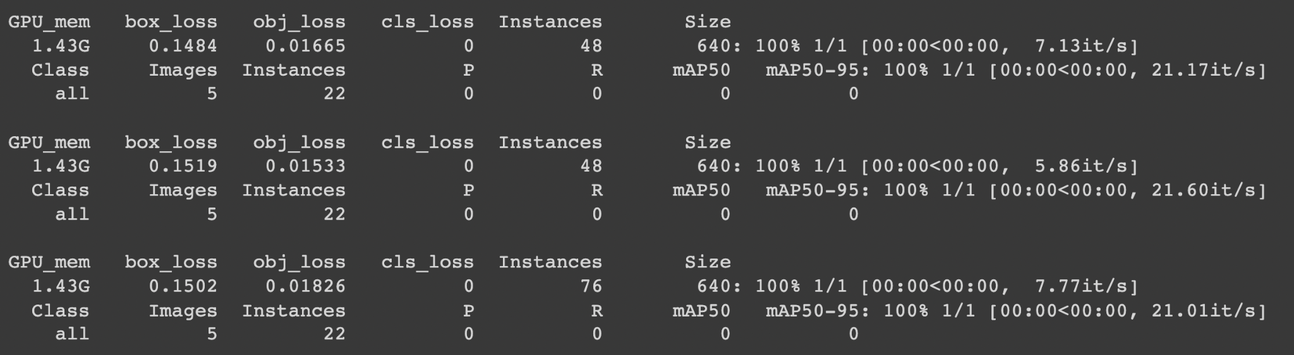
Results from some of the training models:
Zero mAP score.
Zero mAP score. With a variation of the data

Slide 32
This is the 11th attempt, after increasing # of Epochs - the model automatically just stopped training.

Slide 33
Model Training Approach
Model | Application
SVM | Layer classifier / Hyperbola classifier
Random forest | Hyperbola classifier
Decision Tree | Hyperbola classifier
YOLO | Multiclass classifier
CNN | Multiclass classifier / Hyperbola classifier
RCNN | Object detection using bounding boxes
Data split
Single test/train split - 30% training, 70% testing
Tuning the model hyperparameters
Grid search
Random search
Bayesian optimization

Slide 34
Model Training Approach
Feature selection strategies
Decision tree, recursive feature elimination
Model | Features used
SVM | LBP, HoG
Random forest | LPB, HoG
Decision Tree | LBP, number of edge pixels, standard deviation of the mean of rows, mean of peaks and valleys, standard deviation of the image, depth of the sliding window of original gpr image

Slide 35
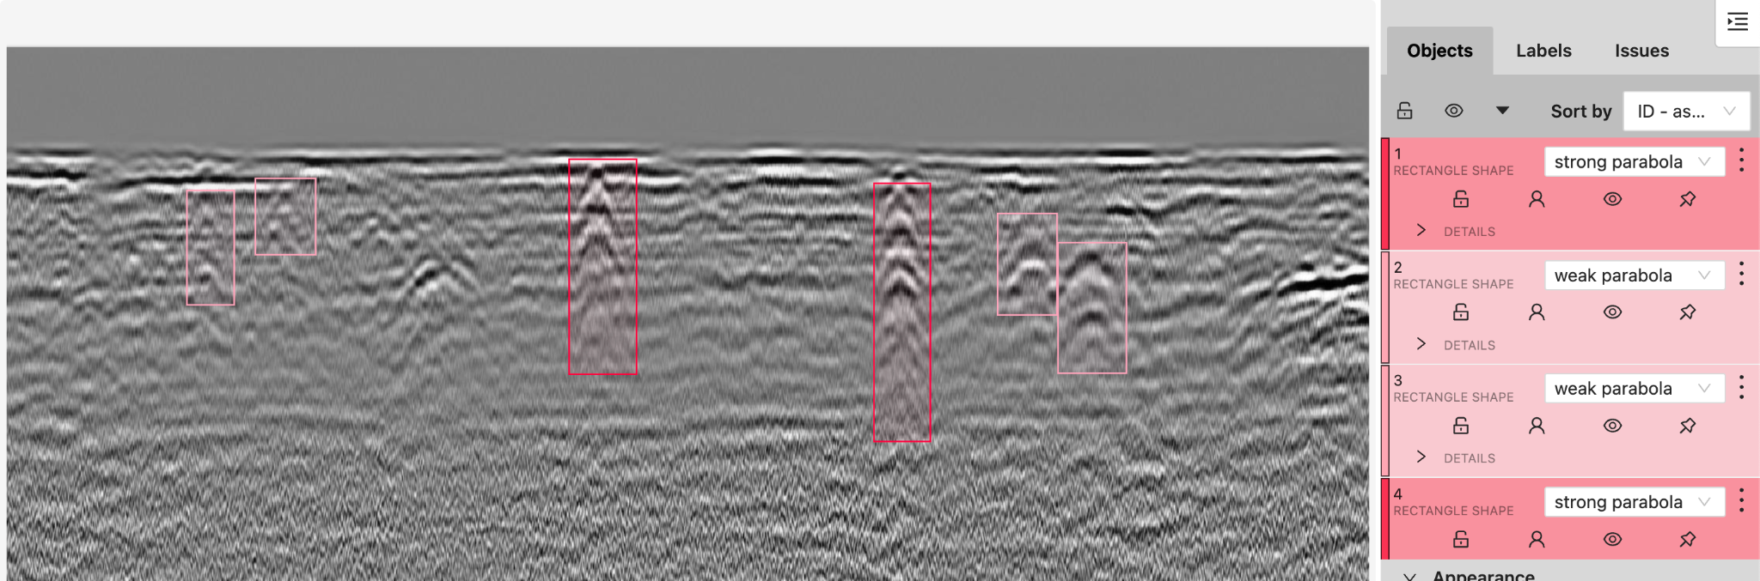
Try Object Detection?
Fig. 1.
Fig 2.

Slide 36
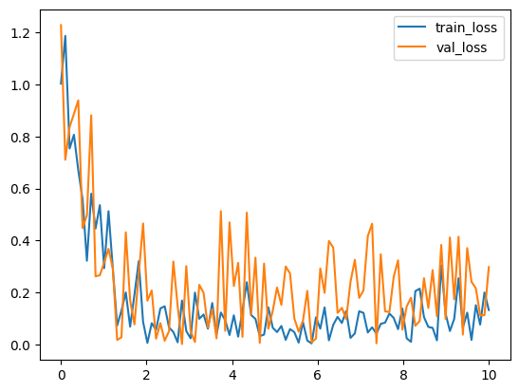
Object Detection? - RCNN
RCNN based object detection.
Possible reasons:
Lack of data
Wrong methodology
Hypothesis:
Lack of unique training samples
Lack of data
Model too big.
Annotations need to be revisited.
Notes:
bhanu

Slide 37
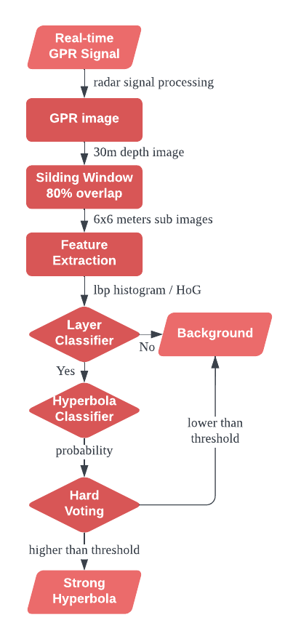
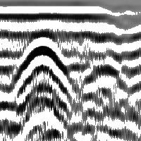

Train different layers individually
Hyperbola and reflector size and texture changes as depths.
Different layer classification
Hyperbola Classification
6m 25m

Slide 38
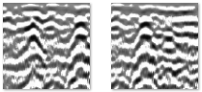
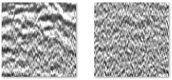
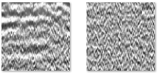
Layer Classifier - SVM
target
When training images from all depths, the model cannot tell hyperbolas from reflectors especially when the dataset is unbalanced.
Use different dataset for training and validation.
Training data: 257 top layer images and 480 background.
Test data: 256 top layer and 663 background.
The texture of top layer images and background have huge difference, use local binary pattern histogram [2](16 bins, normalized) to extract local texture.
Use support vector machines[1](linear kernel) to train the layer classification model.
f1 for target is 0.99. Accuracy is 0.99
background

Slide 39
Layer Classifier - CNN
target
Very simple CNN, interpretable
InterpNet(
(conv1): Conv2d(1, 3, kernel_size=(5, 5), stride=(1, 1), padding=(2, 2))
(fc1): Linear(in_features=120000, out_features=3, bias=True)
)
83.5% accuracy using stochastic gradient descent and cross-entropy loss for training
background

Slide 40
Hyperbola Classifier - Random Forest
Strong Hyperbola
Hyperbolas have clear contours in the top layer, but they are often surrounded by strong reflectors.
Dataset: 50 centered strong hyperbola and 100 strong reflectors.
Use 80% for training, 20% for validation.
The gradient of hyperbolas has huge difference from reflectors, use Histogram oriented Gradient[3](4 sub images, normalized).
Use random forest to train the hyperbola classification model.
Test result: f1 of reflectors: 0.92. f1 of hyperbola: 0.86. Accuracy: 0.9
Strong reflectors

Slide 41
Hyperbola Classifier - Decision Tree
13 features used.
Dataset: 50 centered strong hyperbola and 100 strong reflectors.
Use 80% for training, 20% for validation.
Use Decision tree to train the hyperbola classification model.
Test result: f1 of reflectors: 0.89. f1 of hyperbola: 0.85. Accuracy: 0.87
Tree based model to help calculate the feature importance and help in feature selection for the final chosen model.
lbp_histogram -> 8 bins
number_of_edgePixels -> 9
std_meanOfRows -> 10
mean_PeaksValleys -> 11
np.std -> 12
depth of the image -> 13

Slide 42
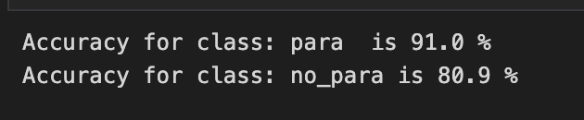
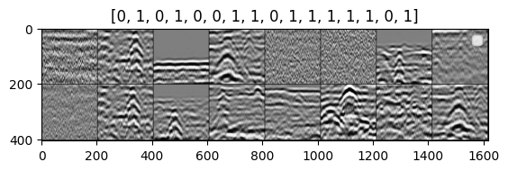
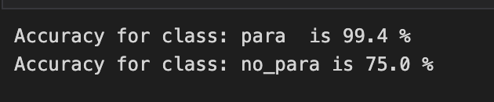
Hyperbola binary classifier - CNN
Split the different shaped images into K*K even sizes.
Preserve the bounding boxes and labels
Try with different K’s (hyperparam?)
Split the M*N image into even K*K small images with stride of H pixels.
K=400*400 and H=10
K=200*200 and H=10
Pros:
Increase in data size.
Cons:
Not a lot of unique samples in the increased set.
Unable to capture hyperbola bigger than K*K
0: Not a Hyperbola
1: Hyperbola
No. Seems like a highly overfitted model. Again, performed quite poorly on the new dataset we received last week
Notes:
bhanu

Slide 43
Model Evaluation - Summary
Model | Features | Application | Result
YOLO | Original GPR Images | multiclass | Models not trained fully
RCNN | Original GPR Images | Multiclass | Cannot converge →Lack of unique training samples / Lack of data
CNN | Cropped images | Layer classifier | 83.5% accuracy
CNN (without attention) | Cropped images | Hyperbola classifier | Accuracy for detecting a hyperbola: 91%
CNN (with attention) | Cropped images | Hyperbola classifier | Accuracy for detecting a hyperbola: 99.4%
SVM | LBP of Cropped images | Layer classifier | F1 = 0.99, Accuracy of top layer = 0.99
SVM | HoG of Cropped images | Hyperbola classifier | Recall = 0 → Need hyperparameter tuning
Decision tree | 13 features used | Hyperbola classifier | f1 of reflectors: 0.89. f1 of hyperbola: 0.85. Accuracy: 0.87
Random forest | HoG of Cropped images | Hyperbola classifier | f1 of reflectors: 0.92. f1 of hyperbola: 0.86. Accuracy: 0.9

Slide 44
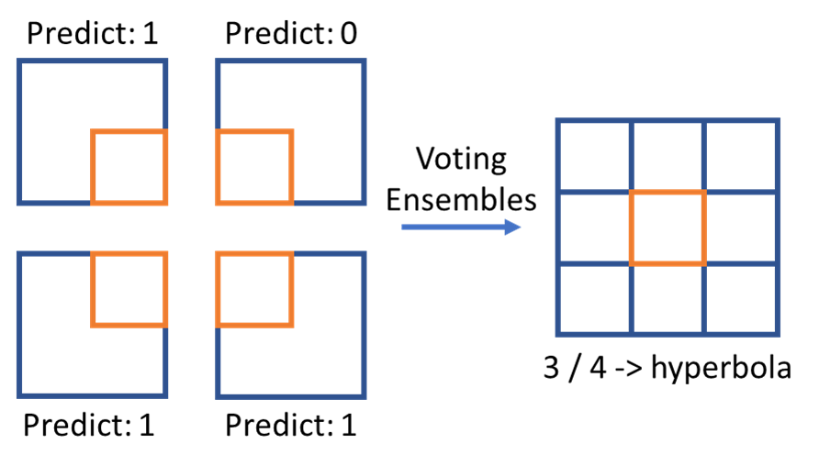
Voting Ensembles
Using voting ensembles to combine multiple predict results for finer granularity.
Sliding windows: 200 x 200 pixels, 80% overlapping
Predict granularity becomes 40 x 40 pixels
Label as hyperbolas with above 50% of vote
Example:
Sliding windows 200 x 200 pixels, 50% overlapping

Slide 45



Inference Pipeline
Extract features from GPR images
Local Binary Pattern histogram
Histogram of Oriented Gradients
Import trained model
LBP histogram + SVM for detecting top layers
HoG + random forest for detecting hyperbolas
Ensemble prediction
Evaluate classification
Generate labeled data
top layer detection
hyperbolas detection

Slide 46

Demo - Hyperbola Detection
Binary Classifier from Winter Presentation

Slide 47
Hardware - Budget
 | Item | Cost per item | Quantity | Total cost (in $)
1 | Raspberry pi 4 B, 8 GB RAM | 195.99 | 2 | 391.98
2 | 32GB C10 SD CARDS | 12.29 | 2 | 24.58
3 | Heat sinks | 4.99 | 1 | 4.99
4 | SD card readers | 11.99 | 2 | 23.98
5 | Power adapters | 15.79 | 1 | 15.79
6 | USB C to A cables | 10.37 | 1 | 10.37
7 | Snapdragon 855 chip |  | 1
8 | GPR device |  | 1

Slide 48
Hardware
Working backwards from end result to get hardware.
Demand issue with SnapDragon
Why testing on different hardware is better
Needs of hardware need to emulate (with safe error margin in performance)
Understanding the difference between tradition ML processing devices

Slide 49
Hardware
Why the Pi?
Represents what we want in our end goal
Support
Easy testing
Accelerated libs with openCV
Allows for almost all methods discussed to be tested (although not modified much)

Slide 50
Hardware
Why the Pi
Represents what we want in our end goal
Support
Easy testing
Accelerated libs with openCV
Allows for almost all methods discussed to be tested (although not modified much)
Issues with the Pi
Still not a snapdragon
Will still need to optimize and convert code to run on snapdragon testboard
Not that great at CPU intensive tasks - main advantage is utility.
Major heating issues, drastic dips in performance

Slide 51
Hardware - Raspberry PI
Processor: Broadcom BCM2711, quad-core Cortex-A72 (ARM v8) 64-bit SoC @ 1.5GHz
RAM: 4GB LPDDR4-3200 SDRAM (shared with GPU)
Storage: microSD card slot for operating system and data storage
Dimensions: 88 x 58 x 19.5 mm, 46 g
Connectivity: Gigabit Ethernet, dual-band 802.11 b/g/n/ac wireless, Bluetooth 5.0 BLE, 2 USB 3.0 ports, 2 USB 2.0 ports, 2 micro-HDMI ports (up to 4Kp60 supported), 3.5mm audio jack
GPIO: 40-pin GPIO header, compatible with previous Raspberry Pi models
Power: 5V DC via USB-C connector (minimum 3A), or GPIO header (minimum 3A)
Steps:
Installing the necessary software libraries on the Rpi4. These include OpenCV, Scikit-Learn, Joblib, Scikit-image, and other dependencies required by your model.
2. Transferring ML model to the Rpi4. Used Filezilla to copy the model file and Processed images to the Rpi's memory.
3.
Python script data_pipeline.py loads the ML model and performs the task. This script imported the necessary libraries and use them to process input images and generated output which is saved in folder.

Slide 52

Running the model on RaspberryPI
Processing Time for 1 image is approx. 1m11.034s

Slide 53

Input Image

Slide 54

Output Image

Slide 55

Output Image (HOG implemented)

Slide 56

Demo

Slide 57

Schedule - Gannt Chart

Slide 58
Risks
Risks:
Insufficient relevant data collection due to difficulties in processing and working with GPR.
Long inference times.
Low explainability of deployed model.
Mitigations
Augment already procured dataset and try less data intensive model architectures.
Find algorithms which can run faster without sacrificing the desired results.
Notes:
bhanu

Slide 59


Future work
Small Hyperbola
Weak Hyperbola
Improve Multi-class classification
Small and weak hyperbolas detection.
CNN approach with new data
Explore interpretability methods
Acquisition of GPR device to acquire more data
Apply GPR data preprocessing techniques

Slide 60
Lessons Learned
Importance of interpretability in Machine learning
Consistency in annotating the data across the group
Dependency of deep learning on data
Calculating feature importance and coming up with relevant features for the finally chosen model(recursive feature elimination)
Model adaptive ability to different size of geologic features

Slide 61
References
[1] Scikit-Learn. Support vector machine. https://scikit-learn.org/stable/modules/svm.html. 2023.
[2] Cao R, Cao J. Radar Emitter Identification with Bispectrum based LBP and Extreme Learning Machine. 2018 IEEE 23rd International Conference on Digital Signal Processing (DSP). 19-21 November 2018.
[3] Torrione PA, et al. Histograms of Oriented Gradients for Landmine Detection in Ground-Penetrating Radar Data. IEEE Transactions on Geoscience and Remote Sensing. 21 May 2013
[4] Linn K, et al. Control-group feature normalization for multivariate pattern analysis of structural MRI data using the support vector machine. NeuroImage. 15 May 2016.
[5] Scikit-Learn. Random Forest Classifier. https://scikit-learn.org/stable/modules/generated/sklearn.ensemble.RandomForestClassifier.html. 2023.
[6] Onyszko K, Fryskowska-Skibniewska, A. A New Methodology for the Detection and Extraction of Hyperbolas in GPR Images. MDPI Remote Sensing. 2 December 2021.
[7] https://scikit-learn.org/stable/modules/generated/sklearn.tree.DecisionTreeClassifier.html

Slide 62
Q&A

